Slide 1
Siskiyou County Agricultural Economics
Prepared for Larry Walker and Associates by
Spencer Cole and Josué Medellín-Azuara
June 24th, 2021

Slide 2
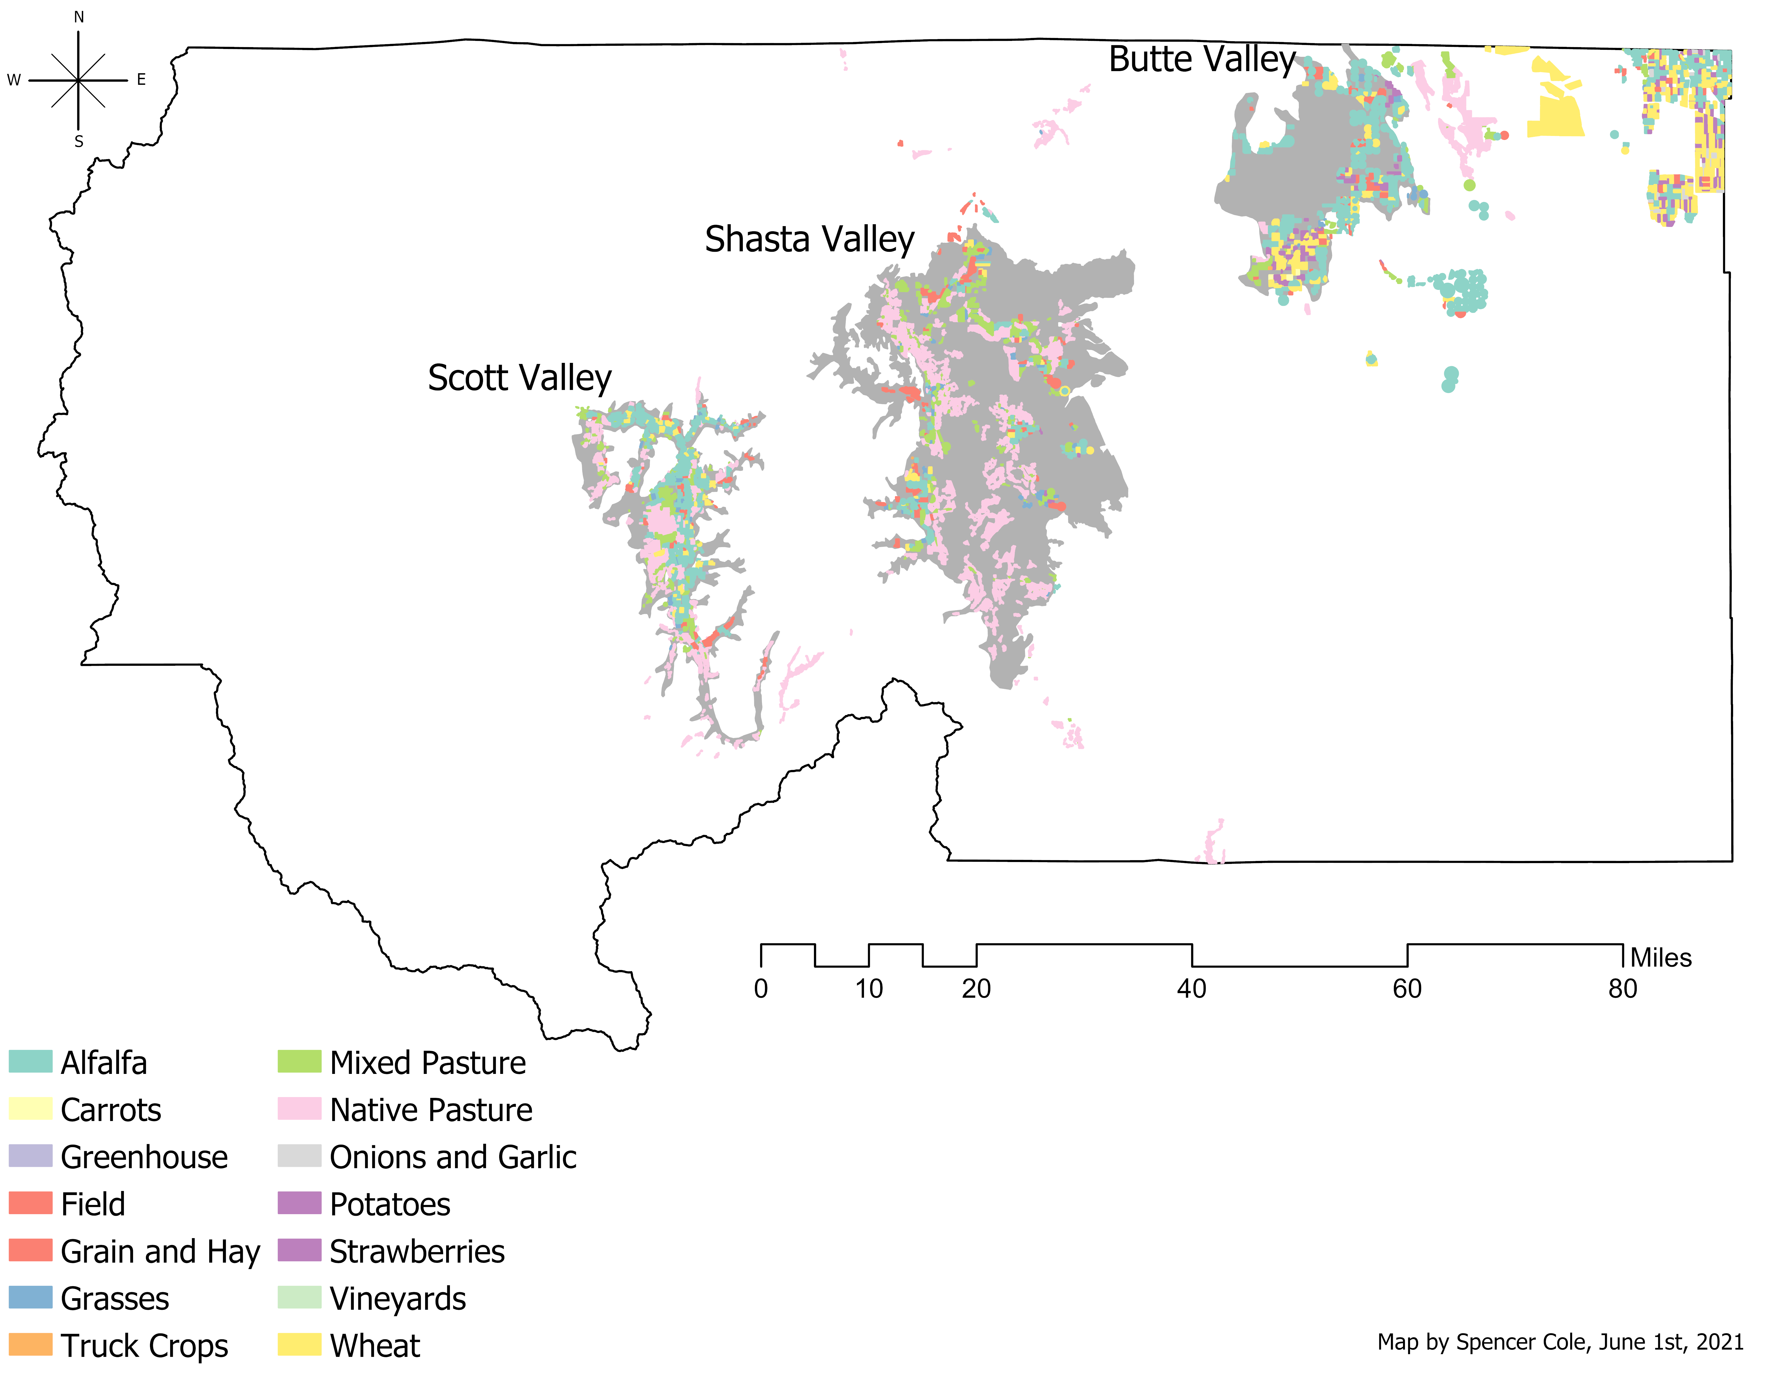
Scope of Work
Siskiyou County
  Scott Valley
  Shasta Valley
  Butte Valley
Model calibrated to 2018 LandIQ data

Slide 3
Data Sources
Data Type | Source
Valley boundaries | DWR
Agricultural land use | LandIQ
Crop prices | Siskiyou County Ag. Commissioner Reports
Crop yields | Siskiyou County Ag. Commissioner Reports
Crop production costs | UC Davis Cost and Return Studies
Applied water | DWR; Scott Valley Integrated Hydrologic Model

Slide 4
Ag Model Overview
Prices
Land use
Irrigation needs
Costs
Yields
Positive Mathematical Programming (PMP)
  Step 1: Shadow values obtained from linear optimization
  Step 2: Calibrate a non-linear cost function
  Step 3: Run a calibrated model
  Step 4: Run scenarios
Base Case
Calibrated model
Scenarios
Cropping patterns
Water use
Gross revenues

Slide 5
Scenario Overview
Scenario 1: 15% fallowing of alfalfa and pasture
Scenario 2: 30% fallowing of alfalfa and pasture
Scenario 3: 60% fallowing of alfalfa and pasture
Scenario 4: 33% fallowing in alfalfa yield
Scenario 5: explore value of strawberries in Butte Valley in context of other crops such as alfalfa
Scenario 6: explore economic impacts of conversion of alfalfa and pasture to less water-intensive crops

Slide 6
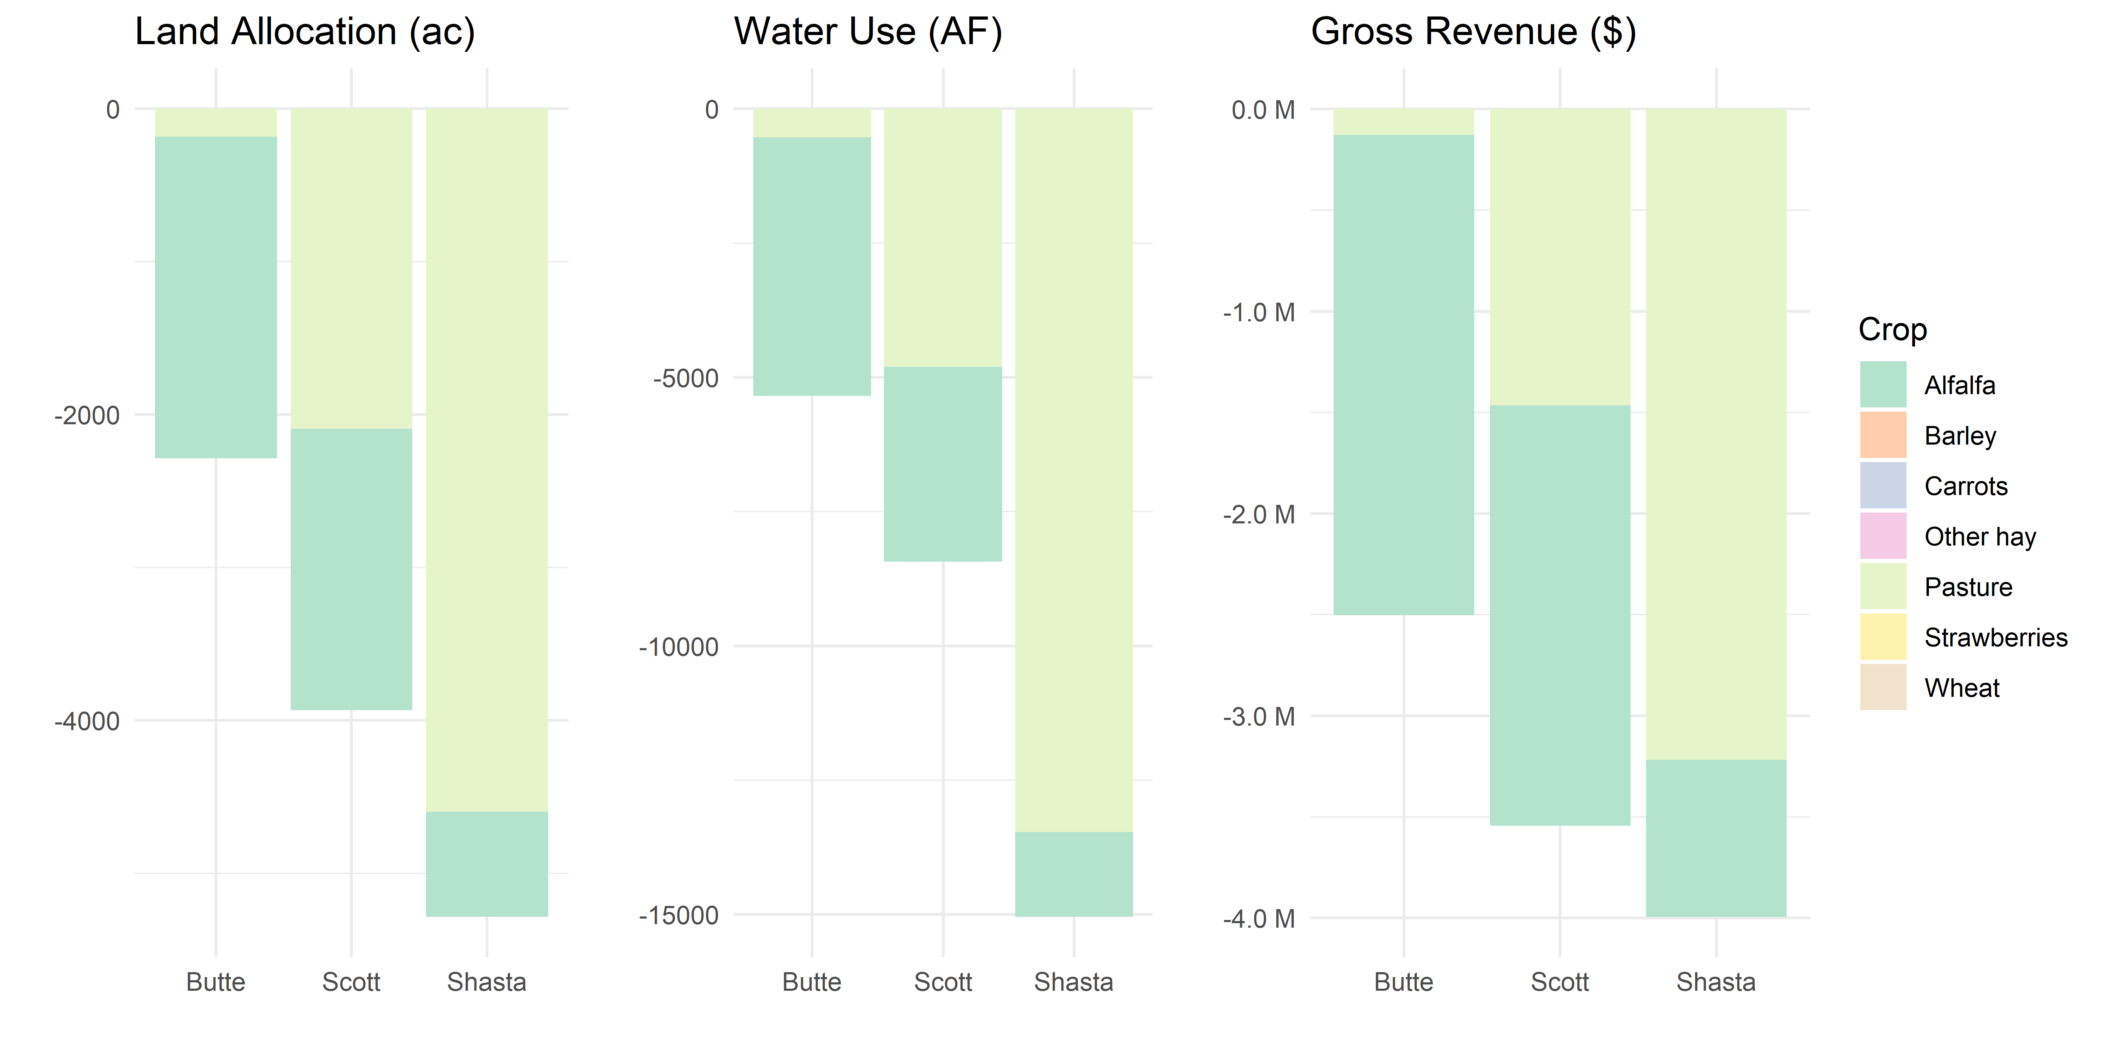
Scenario 1: 15% fallowing of alfalfa and pasture
11,500ac fallowed of 97,000ac
$10 million gross revenue loss of $237 million
29,000AF applied water reduction out of 225,000AF
$869/ac average loss
 | Output ($M) | Value Added ($M) | Jobs
Direct | 10.0 | 5.5 | 67
Total | 13.3 | 7.6 | 93
-2,283 (9.3%) in Butte
-5,348 (10.2%) in Butte
-$2,500,000 (1.5%) in Butte
Changes to land, water, and gross revenue from observed 2018 cropping patterns, prices, and yields.

Slide 7
Butte Valley Scenario 1
 | Land Use (acres) |  | Water Use (acre-feet) |  | Gross Revenue ($ thousand)
Crop | Base | Scenario | Base | Scenario | Base | Scenario
Alfalfa | 14,015 | 11,913 | 32,095 | 27,281 | 15,831 | 13,456
Barley | 1,460 | 1,461 | 2,278 | 2,278 | 961 | 961
Carrots | 227 | 227 | 501 | 501 | 1,093 | 1,093
Other hay | 529 | 529 | 1,211 | 1,212 | 626 | 627
Pasture | 1,215 | 1,033 | 3,561 | 3,027 | 850 | 723
Strawberries | 2,676 | 2,677 | 5,915 | 5,915 | 149,882 | 149,884
Wheat | 4,502 | 4,502 | 7,023 | 7,024 | 2,903 | 2,903
Total | 24,626 | 22,342 | 52,586 | 47,238 | 172,150 | 169,650
Difference |  | -2,283 (9.3%) |  | -5,348 (10.2%) |  | -2,500 (1.5%)

Slide 8
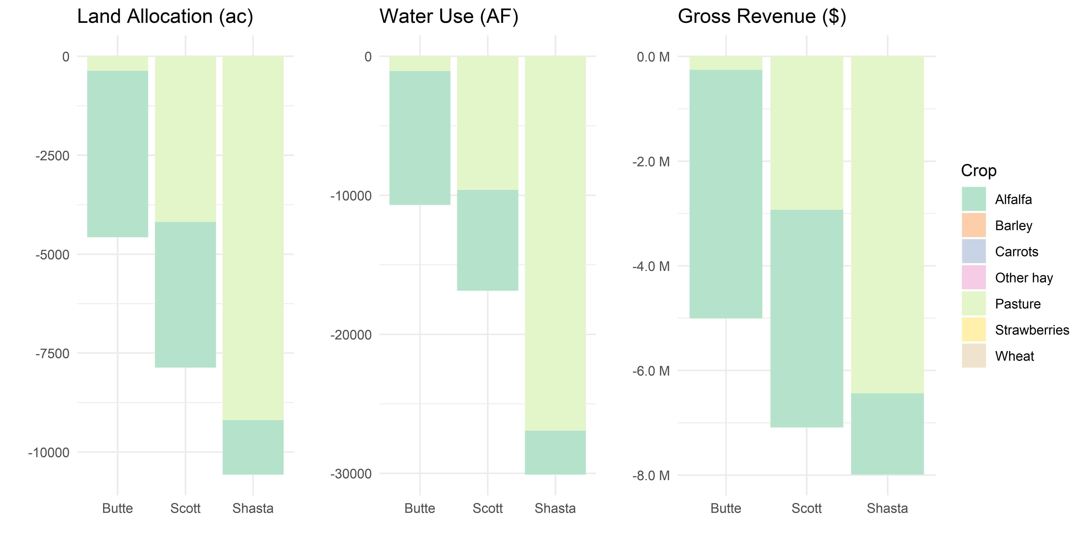
Scenario 2: 30% fallowing of alfalfa and pasture
23,000ac fallowed of 97,000ac
$20 million gross revenue loss of $237 million
57,500AF applied water reduction out of 225,000AF
$869/ac average loss
 | Output ($M) | Value Added ($M) | Jobs
Direct | 20.0 | 11.2 | 134
Total | 26.6 | 15.2 | 186
-4,568 (18.6%) in Butte
-10,695 (20.3%) in Butte
-$5,000,000 (2.9%) in Butte
Changes to land, water, and gross revenue from observed 2018 cropping patterns, prices, and yields.

Slide 9
Butte Valley Scenario 2
 | Land Use (acres) |  | Water Use (acre-feet) |  | Gross Revenue ($ thousand)
Crop | Base | Scenario | Base | Scenario | Base | Scenario
Alfalfa | 14,015 | 9,811 | 32,095 | 22,466 | 15,831 | 11,082
Barley | 1,460 | 1,461 | 2,278 | 2,279 | 961 | 961
Carrots | 227 | 227 | 501 | 501 | 1,093 | 1,094
Other hay | 529 | 529 | 1,211 | 1,212 | 626 | 627
Pasture | 1,215 | 851 | 3,561 | 2,493 | 850 | 595
Strawberries | 2,676 | 2,677 | 5,915 | 5,915 | 149,882 | 149,886
Wheat | 4,502 | 4,503 | 7,023 | 7,024 | 2,903 | 2,903
Total | 24,626 | 20,058 | 52,586 | 41,890 | 172,150 | 167,150
Difference |  | -4,568 (18.5%) |  | -10,695 (20.3%) |  | -5,000 (2.9%)

Slide 10
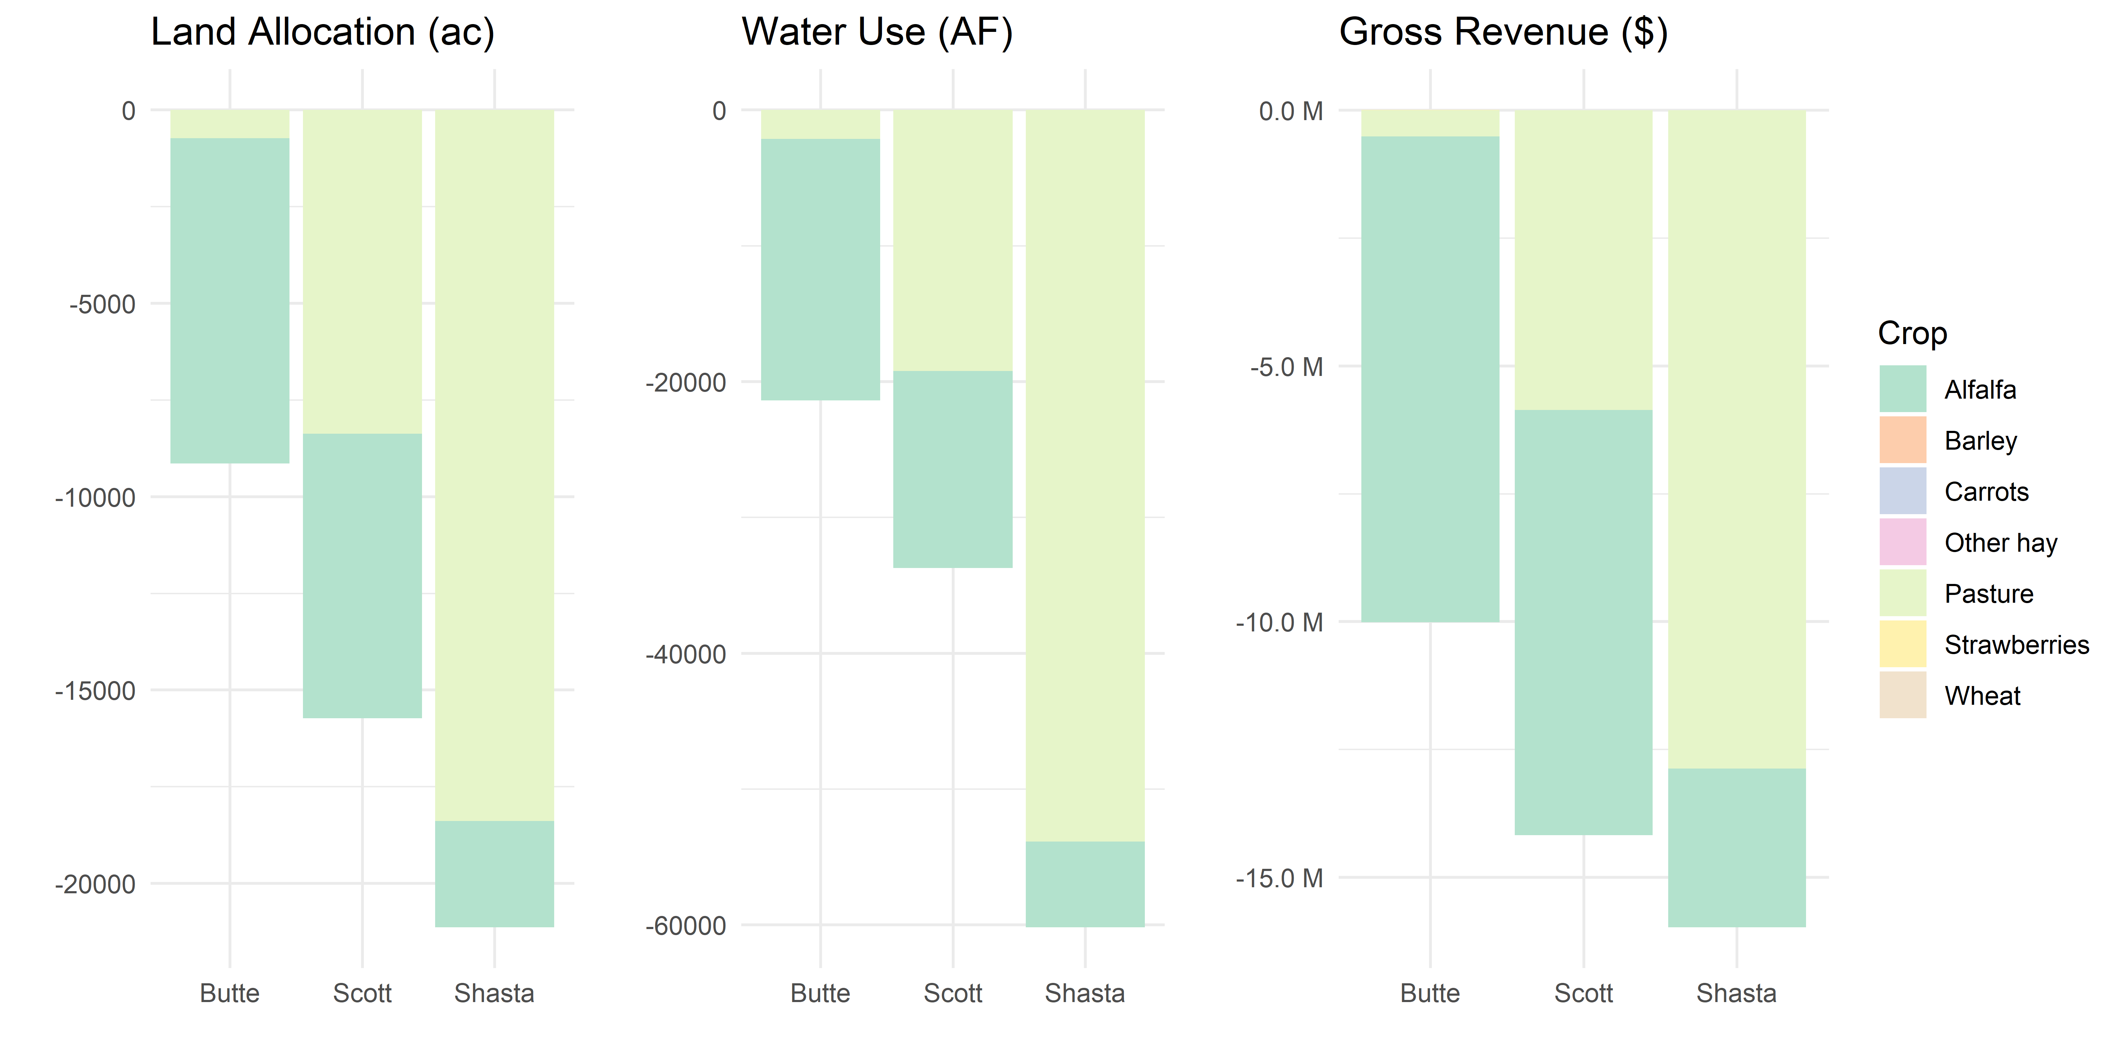
Scenario 3: 60% fallowing of alfalfa and pasture
46,000ac fallowed of 97,000ac
$40 million gross revenue loss of $237 million
115,000AF applied water reductions of 225,000AF
$869/ac average loss
 | Output ($M) | Value Added ($M) | Jobs
Direct | 40.0 | 22.4 | 268
Total | 53.2 | 30.4 | 372
-9,135 (37.1%)
in Butte
-21,392 (40.7%)
in Butte
-$10,000,000 (5.8%)
in Butte
Changes to land, water, and gross revenue from observed 2018 cropping patterns, prices, and yields.

Slide 11
Butte Valley Scenario 3
 | Land Use (acres) |  | Water Use (acre-feet) |  | Gross Revenue ($ thousand)
Crop | Base | Scenario | Base | Scenario | Base | Scenario
Alfalfa | 14,015 | 5,606 | 32,095 | 12,837 | 15,831 | 6,332
Barley | 1,460 | 1,461 | 2,278 | 2,279 | 961 | 961
Carrots | 227 | 227 | 501 | 501 | 1,093 | 1,094
Other hay | 529 | 529 | 1,211 | 1,212 | 626 | 627
Pasture | 1,215 | 486 | 3,561 | 1,424 | 850 | 340
Strawberries | 2,676 | 2,677 | 5,915 | 5,915 | 149,882 | 149,889
Wheat | 4,502 | 4,504 | 7,023 | 7,025 | 2,903 | 2,904
Total | 24,626 | 15,490 | 52,586 | 31,194 | 172,150 | 162,149
Difference |  | -9,135 (37.1%) |  | -21,392 (40.7%) |  | -10,000 (5.8%)

Slide 12
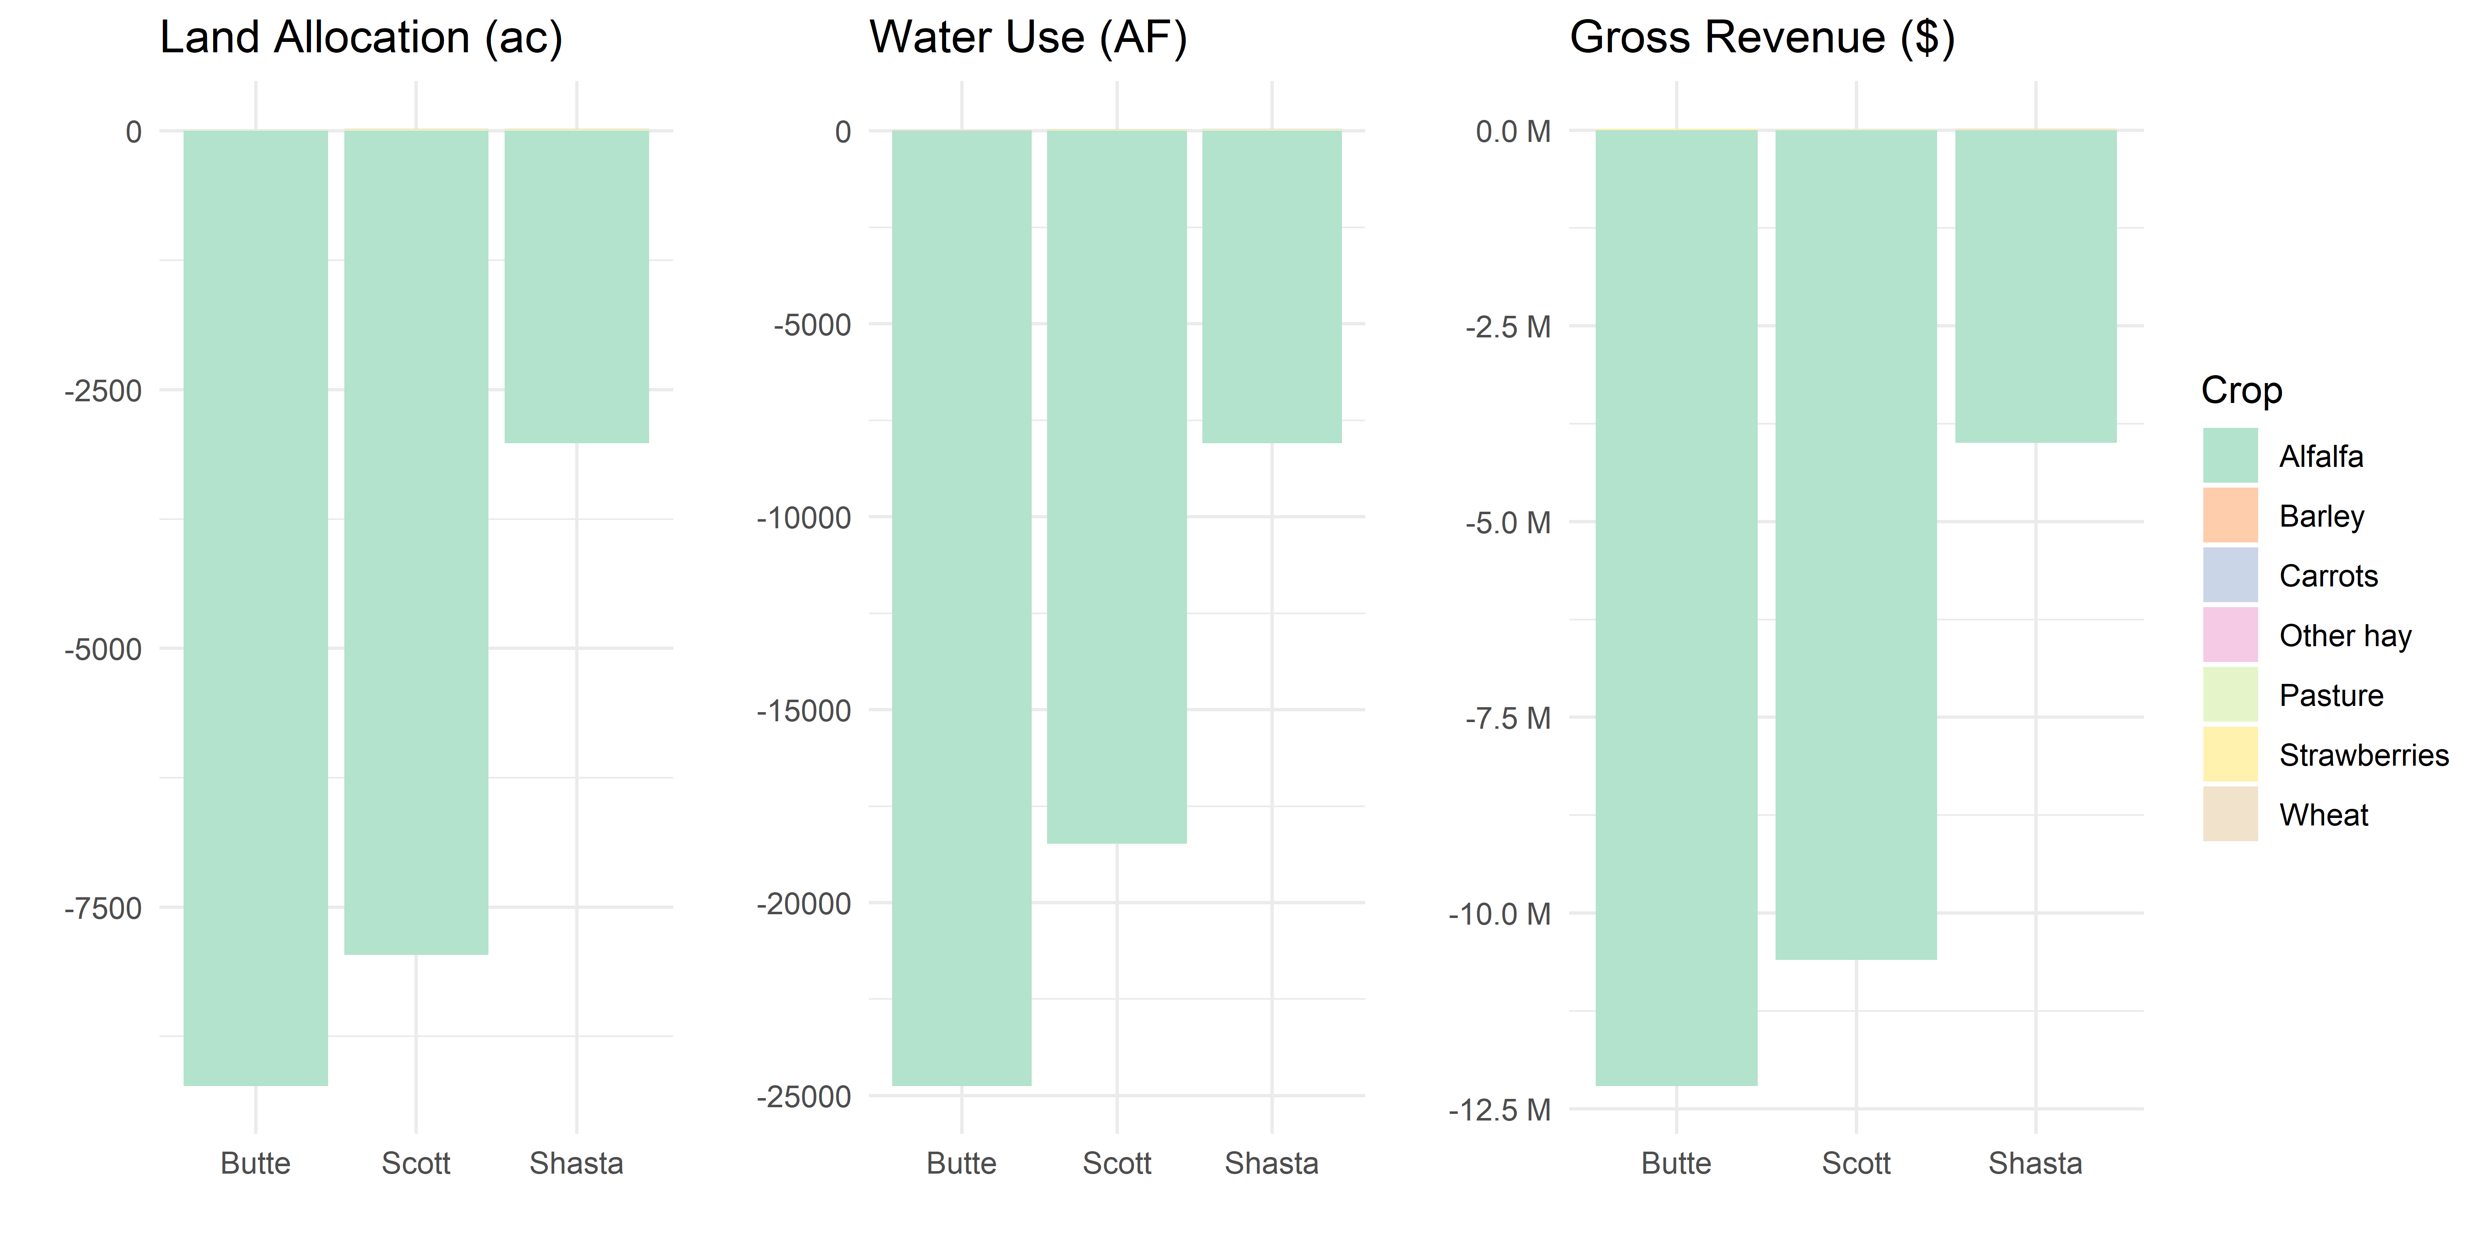
Scenario 4: forego 3rd alfalfa cutting (constant costs)
20,000ac fallowed of 97,000ac
$27 million gross revenue loss of $237 million
51,000AF applied water reductions of 225,000AF
$1350/ac average loss
 | Output ($M) | Value Added ($M) | Jobs
Direct | 27.0 | 14.9 | 182
Total | 35.9 | 20.5 | 251
-9,223 (37.4%)
in Butte
-24,741 (47.1%)
in Butte
-$12,190,000 (7.1%)
in Butte
Changes to land, water, and gross revenue from observed 2018 cropping patterns, prices, and yields.

Slide 13
Butte Valley Scenario 4 (constant costs)
 | Land Use (acres) |  | Water Use (acre-feet) |  | Gross Revenue ($ thousand)
Crop | Base | Scenario | Base | Scenario | Base | Scenario
Alfalfa | 14,015 | 4,785 | 32,095 | 7,342 | 15,831 | 3,621
Barley | 1,460 | 1,461 | 2,278 | 2,280 | 961 | 962
Carrots | 227 | 227 | 501 | 501 | 1,093 | 1,094
Other hay | 529 | 529 | 1,211 | 1,212 | 626 | 627
Pasture | 1,215 | 1,216 | 3,561 | 3,563 | 850 | 851
Strawberries | 2,676 | 2,677 | 5,915 | 5,916 | 149,882 | 149,897
Wheat | 4,502 | 4,505 | 7,023 | 7,029 | 2,903 | 2,905
Total | 24,626 | 15,402 | 52,586 | 27,844 | 172,150 | 159,959
Difference |  | -9,223 (37.4%) |  | -24,741 (47.1%) |  | -12,190 (7.1%)

Slide 14
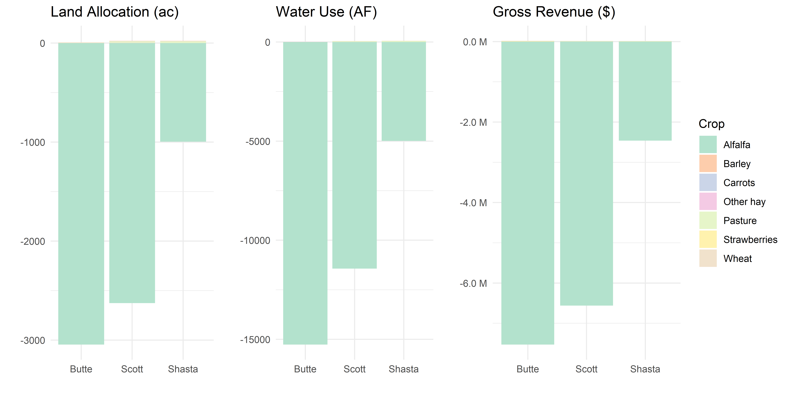
Scenario 4: forego 3rd alfalfa cutting (scaling costs)
6,600ac fallowed of 97,000ac
$16.5 million gross revenue loss of $237 million
31,500AF applied water reductions of 225,000AF
 | Output ($M) | Value Added ($M) | Jobs
Direct | 16.5 | 9.1 | 111
Total | 21.9 | 12.5 | 153
-3,039 (12.3%)
in Butte
-15,252 (29.0%)
in Butte
-$7,506,000 (4.3%)
in Butte
Changes to land, water, and gross revenue from observed 2018 cropping patterns, prices, and yields.

Slide 15
Butte Valley Scenario 4 (scaled costs)
 | Land Use (acres) |  | Water Use (acre-feet) |  | Gross Revenue ($ thousand)
Crop | Base | Scenario | Base | Scenario | Base | Scenario
Alfalfa | 14,015 | 10,971 | 32,095 | 16,832 | 15,831 | 8,302
Barley | 1,460 | 1,461 | 2,278 | 2,280 | 961 | 962
Carrots | 227 | 227 | 501 | 501 | 1,093 | 1,094
Other hay | 529 | 529 | 1,211 | 1,212 | 626 | 627
Pasture | 1,215 | 1,216 | 3,561 | 3,563 | 850 | 851
Strawberries | 2,676 | 2,677 | 5,915 | 5,916 | 149,882 | 149,897
Wheat | 4,502 | 4,505 | 7,023 | 7,029 | 2,903 | 2,905
Total | 24,626 | 21,587 | 52,586 | 37,333 | 172,150 | 164,640
Difference |  | -3,039 (12.3%) |  | -15,252 (29.0%) |  | -7,506 (4.3%)

Slide 16
Conclusions and Next Steps
Model shows good potential to quantify economic cost of various land and water use strategies
Follow up with some growers to fill in any data gaps, caveats
We will continue with scenario development in the next few days including regionwide spill over effects
Start drafting final report and prepare a spreadsheet with model results

Slide 17
Crop Parameters
Crop Type | Price ($/ton) | Yield (ton/ac) | Costs ($/ac) | Gross Revenue ($/ac) | Net Revenue ($/ac) | Net Margin as % of Gross Return
Alfalfa | 183 | 6.2 | 1,073 | 1,129 | 56 | 5%
Barley | 235 | 2.8 | 627 | 658 | 32 | 5%
Carrots | 162 | 29.7 | 4,592 | 4,824 | 232 | 5%
Other Hay | 268 | 4.4 | 1,128 | 1,185 | 56 | 5%
Pasture | 200 | 3.5 | 647 | 700 | 53 | 8%
Strawberries* | 0.14 | 400,000 | 47,622 | 56,000 | 8,377 | 15%
Wheat | 204 | 3.2 | 627 | 644 | 18 | 3%
*Units in terms of nursery plants rather than tons.

